Slide 2
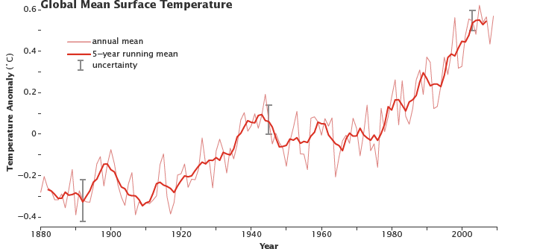
Climate Change & Extreme Events
Average global temperature on Earth is increasing
Source: earthobservatory.nasa.gov/Features/GlobalWarming/page2.phpv
Notes:
We have recorded data on Earth temperatures since 1880. Ask students to describe the trend of this graph [answer: temperature is increasing].

Slide 3
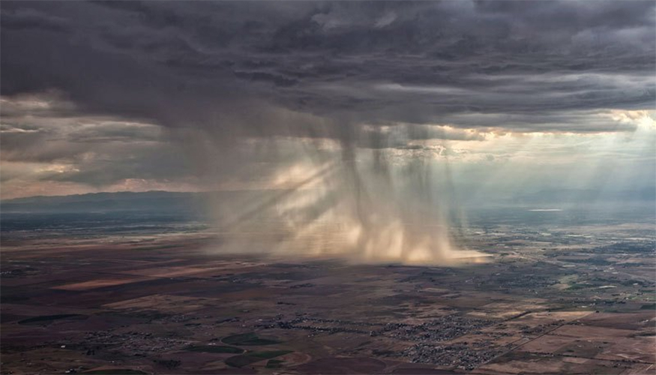
Climate Change & Extreme Events
Warmer temperatures result in more water evaporating into the air
More water in atmosphere means that frequency and intensity of extreme precipitation likely to increase
Source: www.llnl.gov/news/climate-models-overestimate-rainfall-increases
Notes:
As we saw in the graph, temperatures are increasing. Warmer temperatures result in more water evaporating into the air because warm water evaporates more readily. Plus, warmer air can hold more water. Because there is more water in the atmosphere, the frequency of intense precipitation will increase in some areas, and we will see more extreme events.

Slide 4
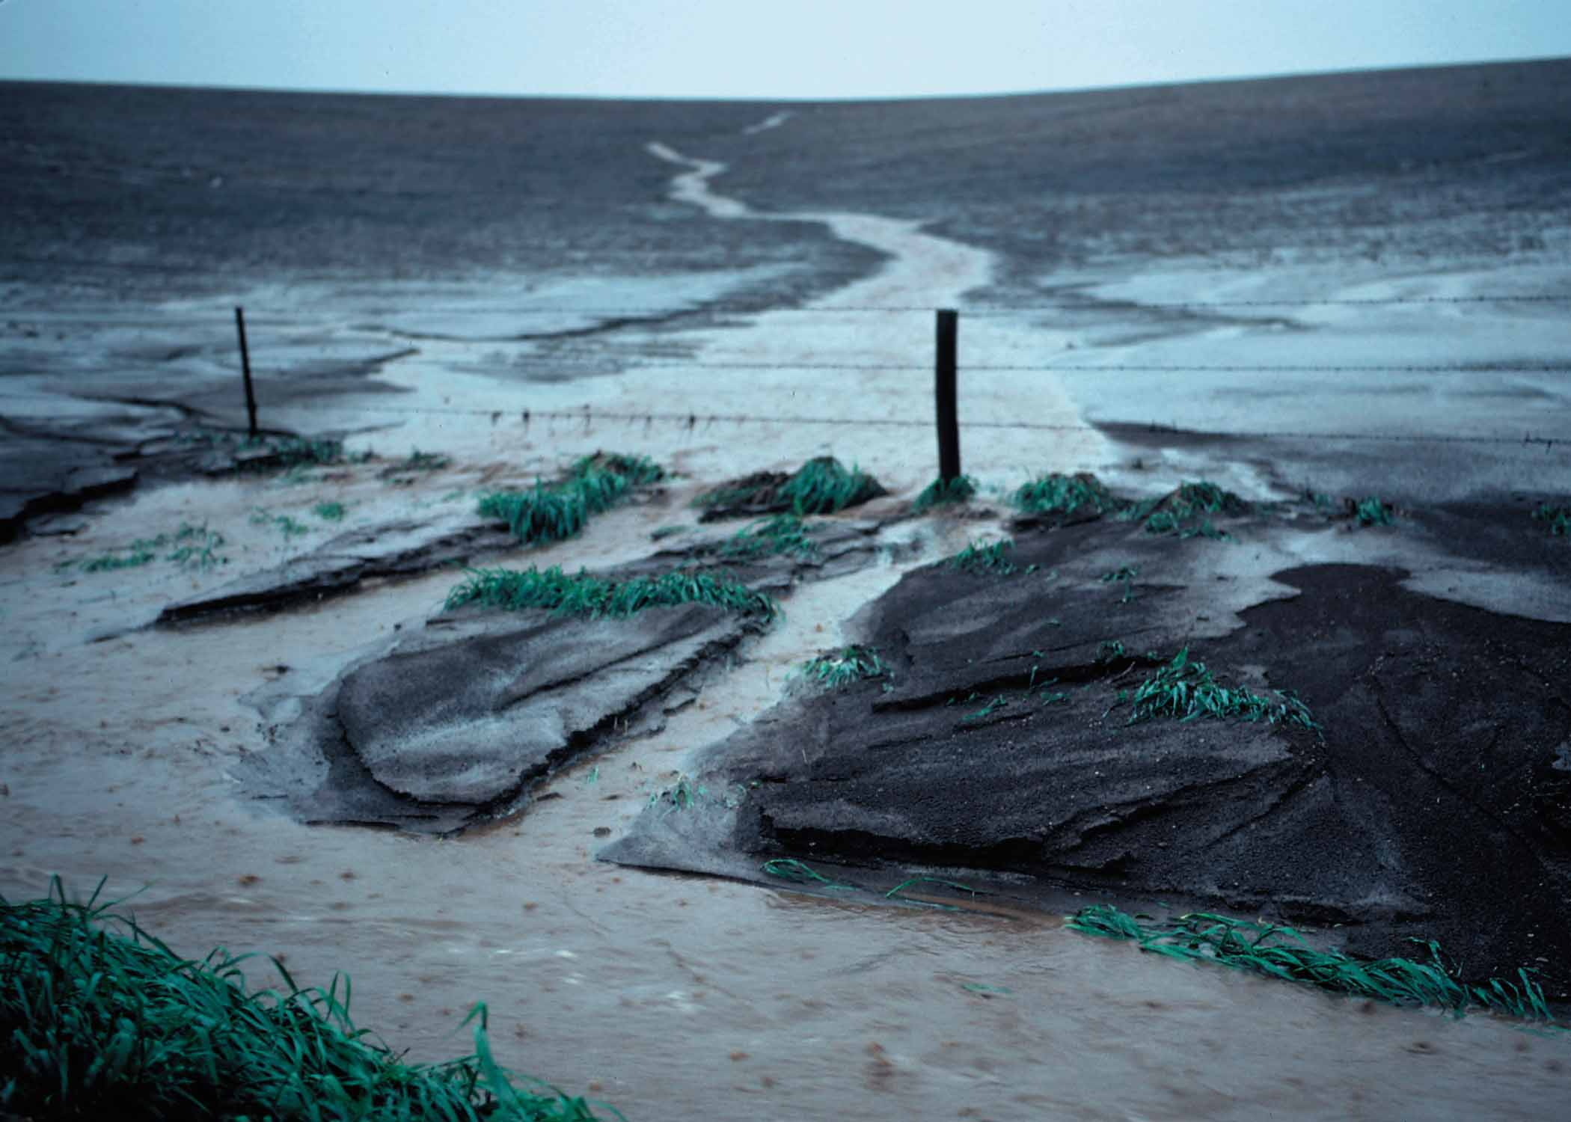
Climate Change & Extreme Events
Soil erosion: wearing away of soil by physical forces of water and/or wind
Extreme precipitation can erode soil
Source:www.nrcs.usda.gov/wps/portal/nrcs/main/national/landuse/crops/erosion/
Notes:
Soil erosion is the wearing away of soil by water or wind. As we saw in our model, extreme precipitation can erode soil.

Slide 5
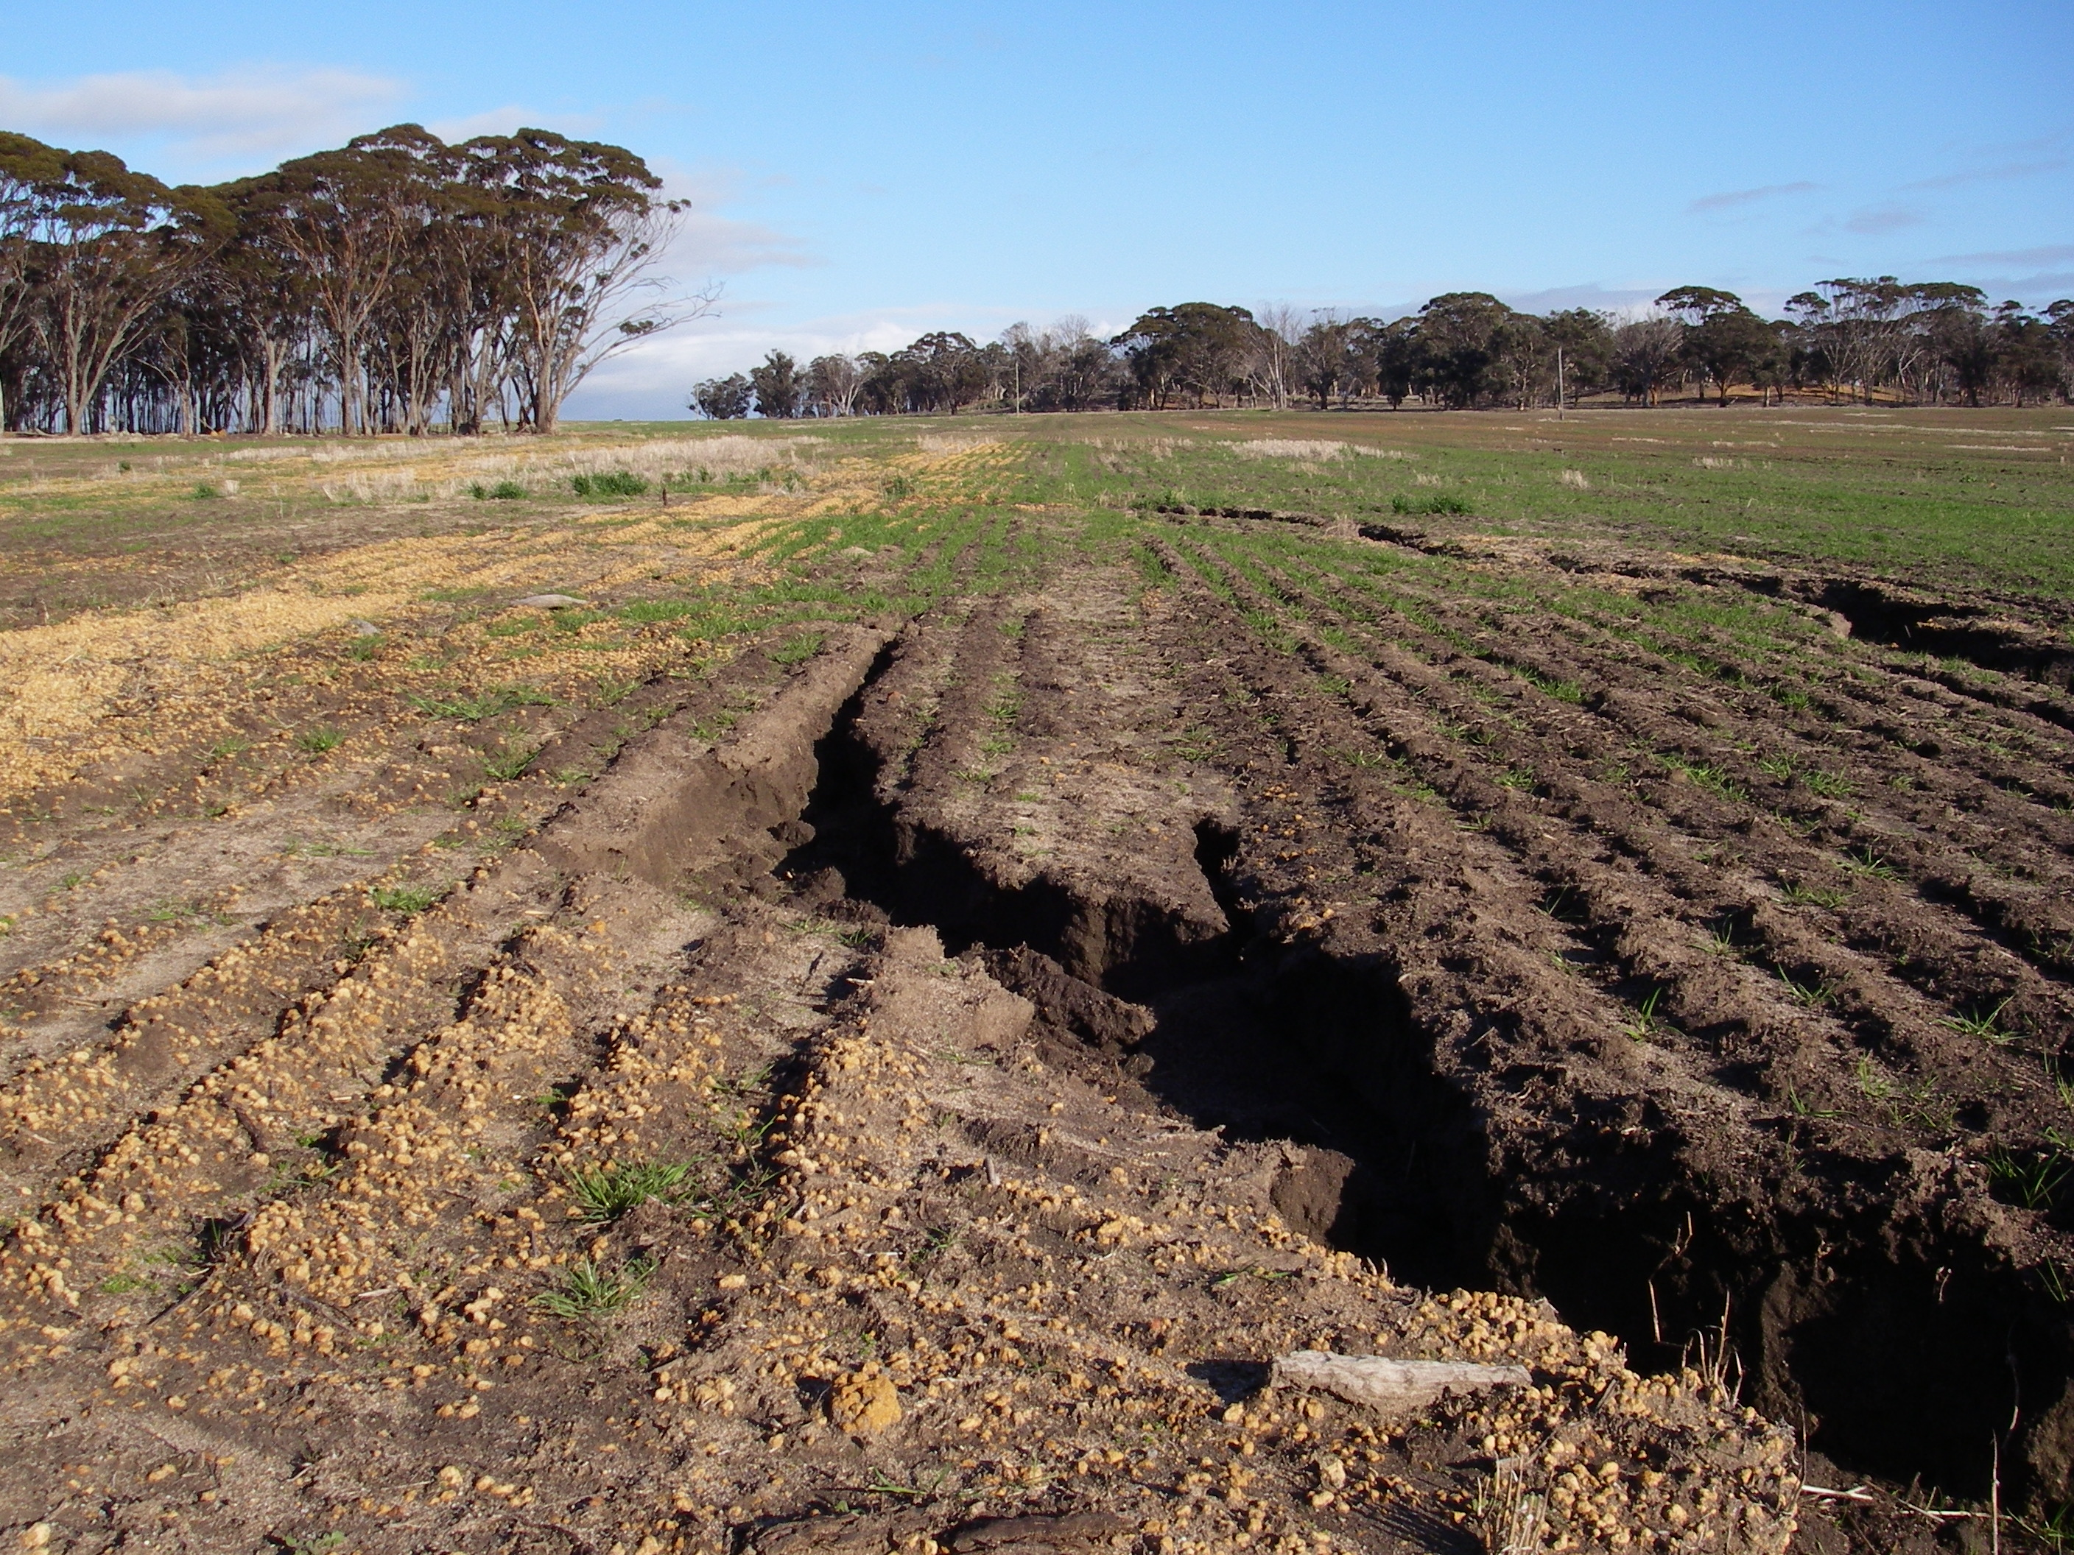
Soil Quality & Extreme Precipitation
Imaginary farm
You will examine the soil quality before and after an extreme precipitation event
  Erosion of topsoil
  (the top 0-20
  cm of soil, which is
  usually more
  nutrient rich)
Source: www.agric.wa.gov.au/water-erosion/water-erosion-introduction?page=0%2C3
Notes:
Pretend that you manage an imaginary farm that will be hit by extreme rain. You are going to examine the soil quality before and after the extreme precipitation event. This extreme precipitation event will erode much of the topsoil, which is the top 0-20 cm of soil. Topsoil is usually more nutrient rich than lower layers of soil.
You will be measuring the pH and nutrients of the topsoil (before the extreme event) and lower layer of soil (after the extreme event) on your imaginary farm.

Slide 6
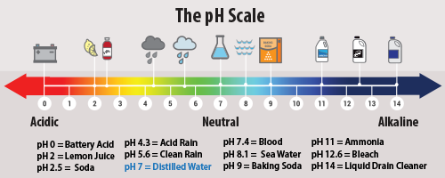
Soil Quality Testing
pH: how acidic or basic a solution is
  Most vegetables need fairly neutral or slightly acidic soil (6.0-7.0)
Source: www.epa.gov/acidrain/what-acid-rain
Notes:
pH is how acidic or basic a solution is. Vegetables need fairly neutral or slightly acidic soil.
[Give examples of the pH of common household solutions from the graphic.]

Slide 7
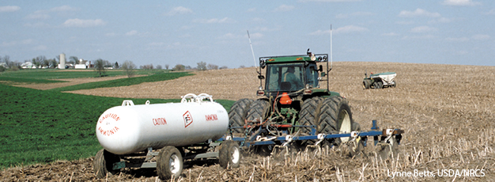
Soil Quality Testing
Nutrient: substance that provides needed components for energy or growth
Source: www.ers.usda.gov/amber-waves/2004-february/us-increasingly-imports-nitrogen-and-potash-fertilizer.aspx#.V6FV6GU5BFI
Notes:
In agriculture, it is important to provide nutrients for the crops. A nutrient is a substance that provides needed components for energy or growth.

Slide 8
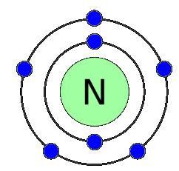
Soil Quality Testing
Nitrogen: needed to make molecules for necessary functions
  Photosynthesis (chlorophyll)
  Energy (ADP, ATP)
  Proteins (structures, enzymes)
  Genetic material (DNA)
Plant needs vary
  Low: soybeans, peas, tomatoes, squash
  High: potatoes, corn, broccoli, cabbage
Source: www.ars.usda.gov/Main/docs.htm?docid=15744
Notes:
An important nutrient for plants is nitrogen. It is needed to make molecules for necessary functions, such as chlorophyll, energy molecules, proteins, and DNA. Crops that need low nitrogen are beans, peas, tomatoes, and squash. Crops that need high nitrogen are potatoes, corn, broccoli, and cabbage.

Slide 9
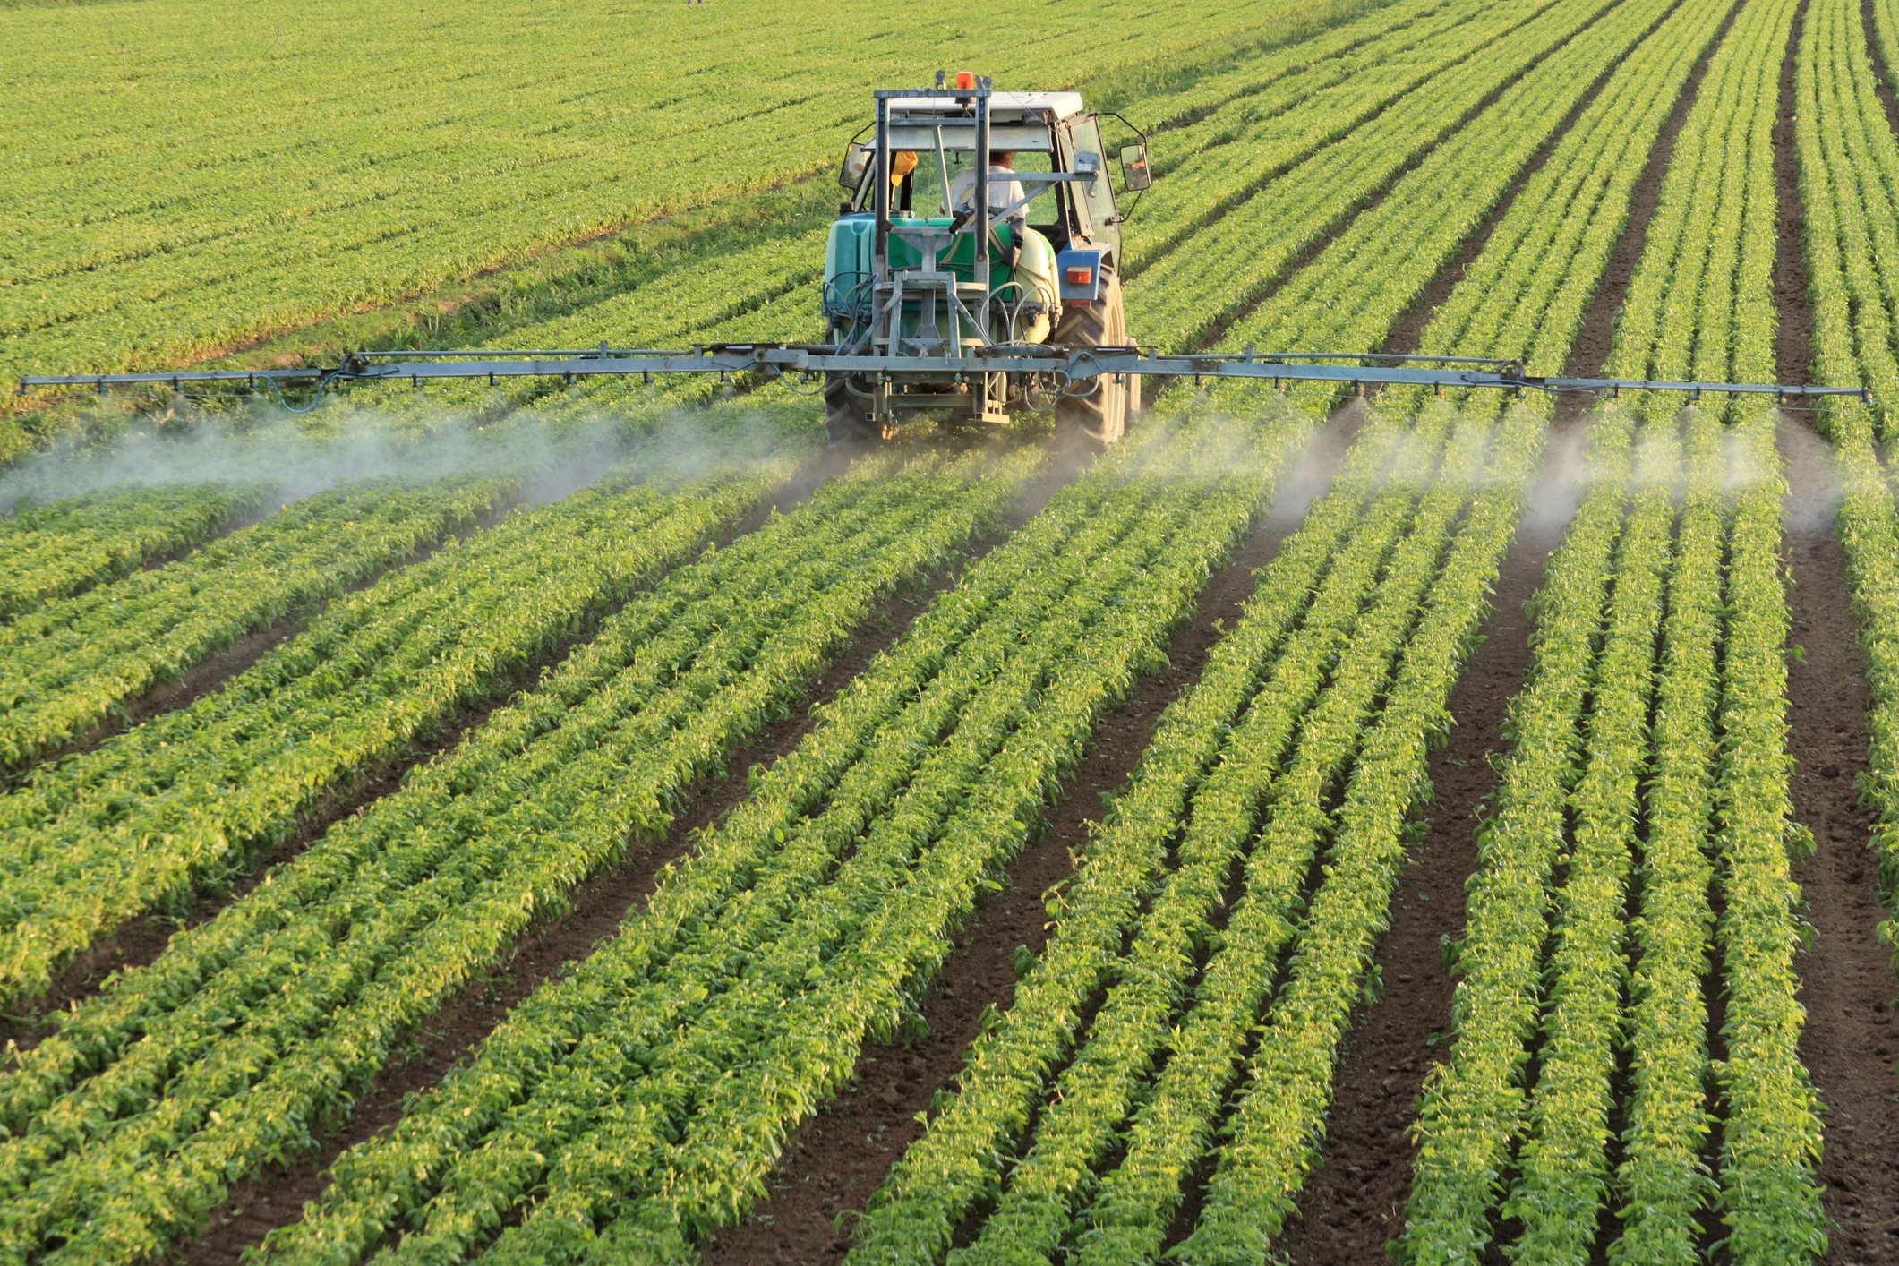
Soil Quality Testing
Phosphorus: needed to make molecules for necessary functions
  Energy (ADP, ATP)
  Genetic material (DNA, RNA)
High need nutrient for most plants
Source: www.bls.gov/opub/btn/volume-2/growing-demand-for-fertilizer-keeps-prices-high.htm
Notes:
Phosphorous is also an important nutrient for making molecules for necessary functions, such as energy molecules and DNA. It is a high need nutrient for most plants.

Slide 10
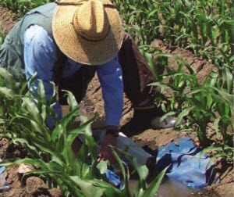
Soil Quality Testing
Potash (Potassium)
  Sustains plant growth and reproduction
    Used to build plant structures
    Aids in photosynthesis
Source: www.cdfa.ca.gov/oefi/healthysoils/
Notes:
Potassium or potash is a nutrient that helps sustain plant growth and reproduction. It is used to build plant structures and aids in photosynthesis.

Slide 11
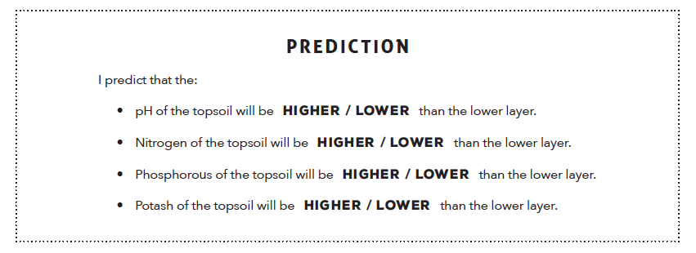
Soil Quality Testing
Make a prediction
Notes:
Predict whether the pH and each of the nutrients will be higher or lower in the topsoil (before the extreme event) than the lower layer (after the extreme event). Circle “higher” or “lower” for each nutrient/pH.

Slide 12
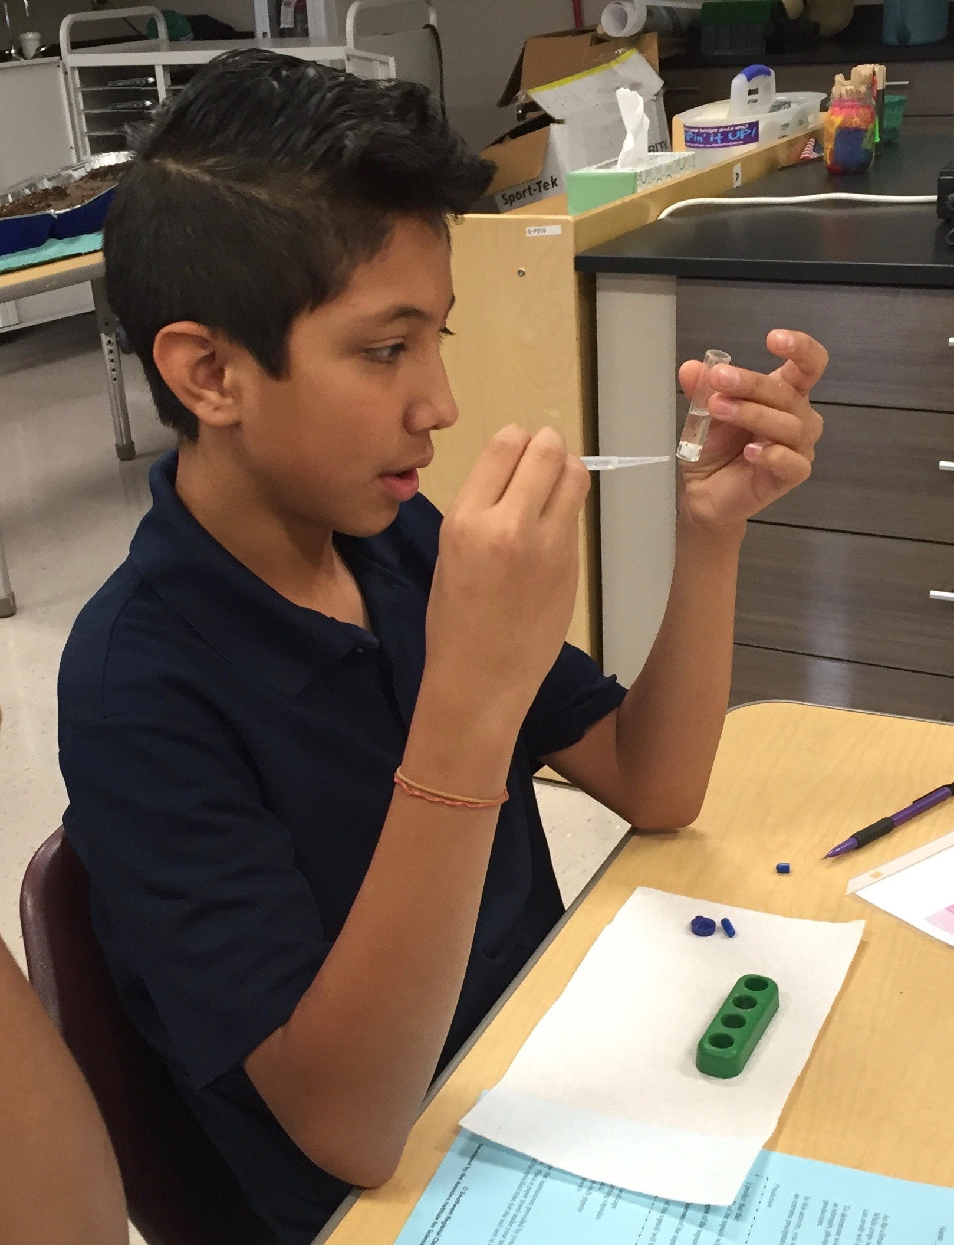
Soil Quality Testing
Follow instructions to test
Notes:
We will begin our soil quality test in groups.

Slide 13
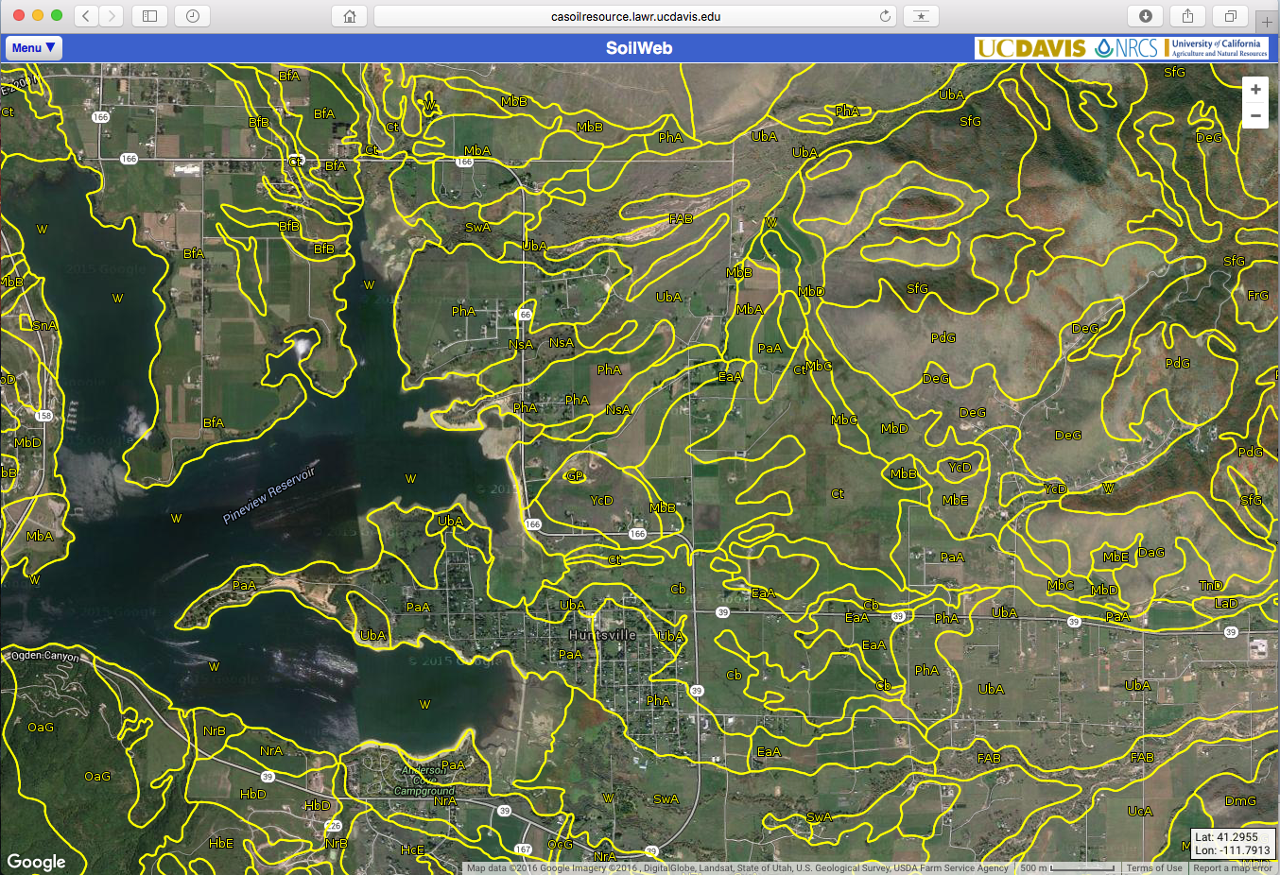
Comparing Soil on
Agricultural Lands with SoilWeb
Computer or tablet with internet access
Source: casoilresource.lawr.ucdavis.edu/gmap/
Notes:
While the soil tests are developing, we will conduct an investigation of agricultural soil in different locations using the online map tool, SoilWeb.

Slide 14
Comparing Soil on
Agricultural Lands with SoilWeb
SoilWeb created with soil data collected by the USDA-NRCS
  US Department of Agriculture-Natural Resources Conservation Service
Surveys conducted on the ground
  Soil samples analyzed in laboratories
Information about soil is used by farmers, foresters, ecologists, and many others
Notes:
SoilWeb was created with soil data collected by the USDA-NRCS. To gather the data, soil scientists conducted soil surveys on the ground and collected soil samples to be tested in laboratories. This information is useful to many people including farmers, foresters, and ecologists. For example, agricultural producers can use this information to help determine if a plot of land has favorable soil characteristics for crops.

Slide 15
Type “SoilWeb” into a search engine to find a link to the website.
Click on the link, or type this URL into your browser: casoilresource.lawr.ucdavis.edu/soilweb-apps/
A pop-up will appear, click ok.
Click in the upper left corner on Menu.
Source: casoilresource.lawr.ucdavis.edu/gmap/
Notes:
Go to the California Soil Resource Lab SoilWeb Apps: casoilresource.lawr.ucdavis.edu/soilweb-apps/. Click on the SoilWeb link. Click “OK” on the pop-up message. Click in the upper left corner on Menu.

Slide 16
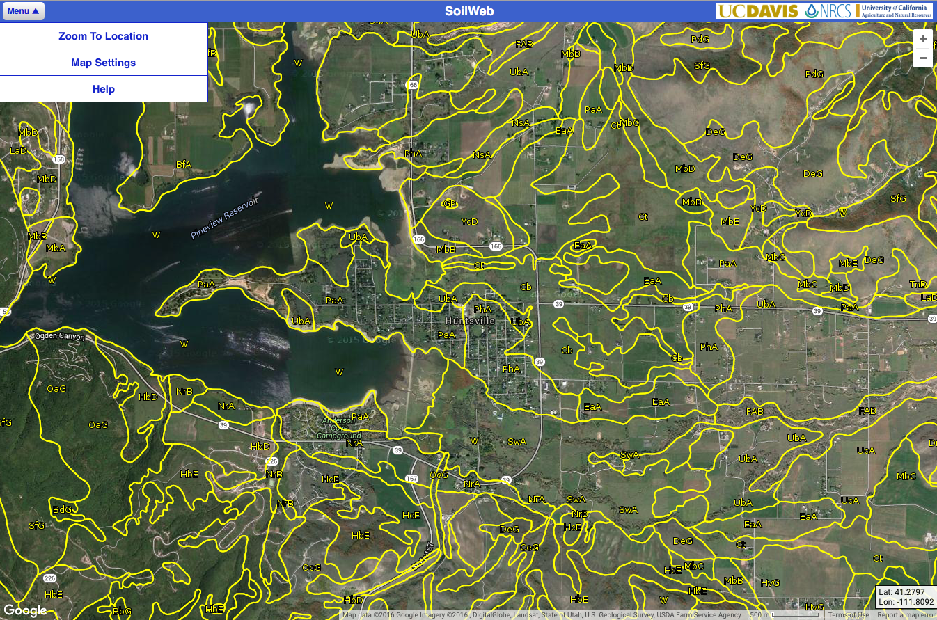
On the dropdown menu, click Zoom to Location.
Source: casoilresource.lawr.ucdavis.edu/gmap/
Notes:
On the dropdown menu, click Zoom to Location.

Slide 17
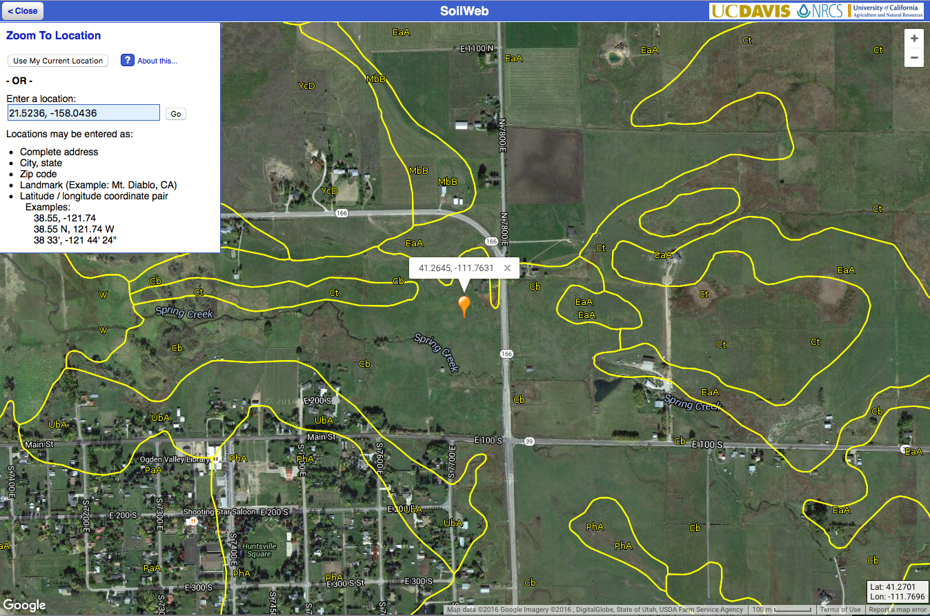
Enter your longitude and latitude coordinates and click Go.
Source: casoilresource.lawr.ucdavis.edu/gmap/
Notes:
In the “Enter a location” box, enter the latitude and longitude for the first location in the Soil Variables table and press Enter.

Slide 18
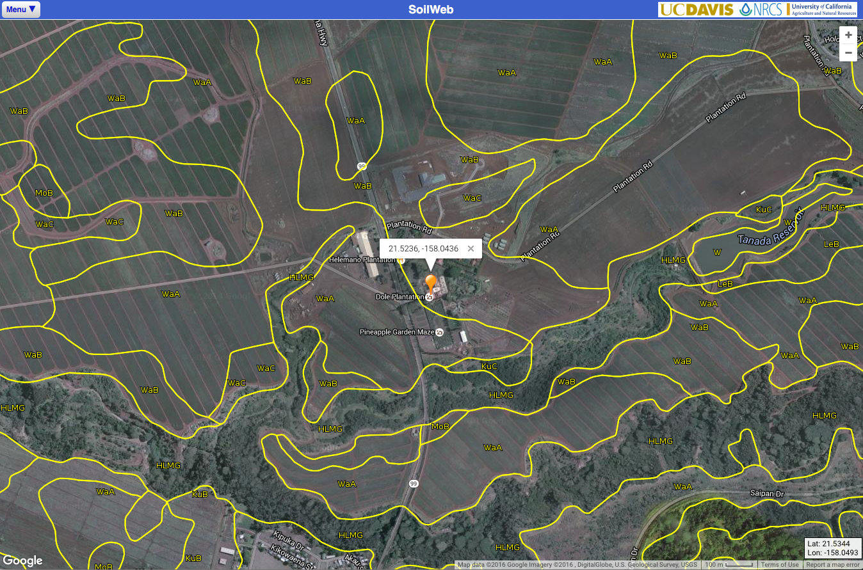
Locate your soil code and click on that code.
Source: casoilresource.lawr.ucdavis.edu/gmap/
Notes:
Locate the soil code for the location and click on that code.

Slide 19
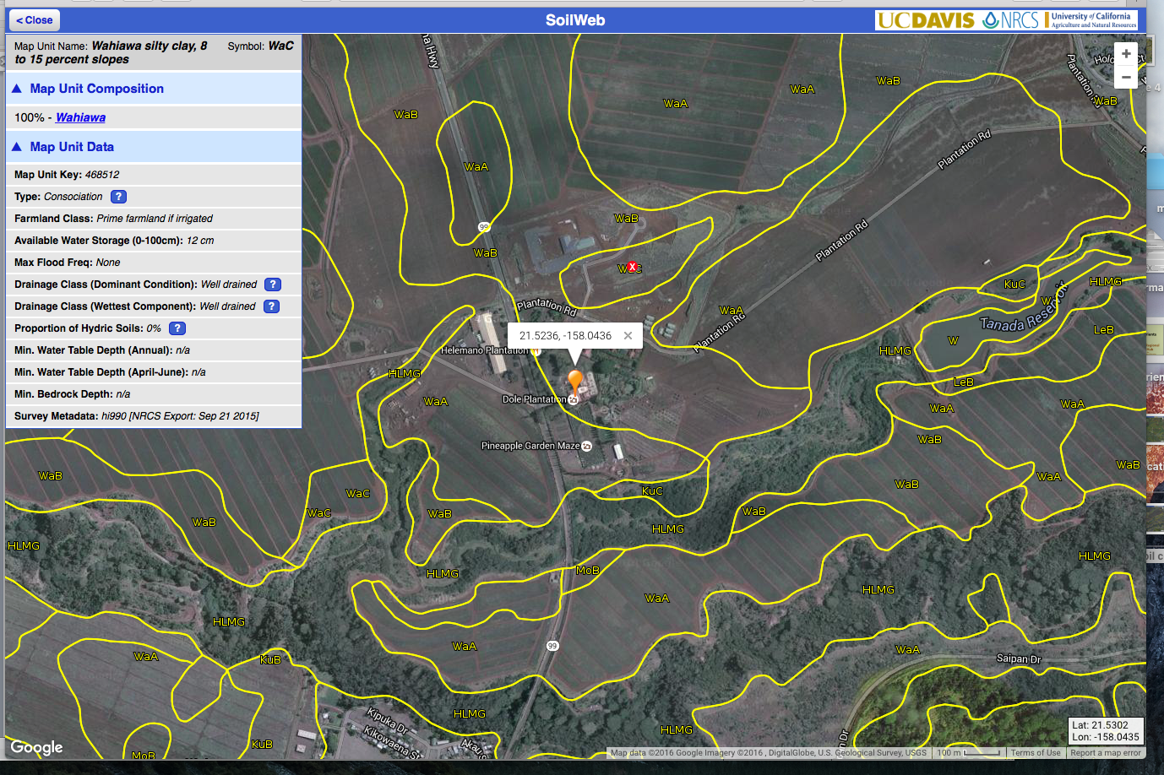
Data for your soil type will appear on the left. Select the soil component that comprises most of the map unit.
Source: casoilresource.lawr.ucdavis.edu/gmap/
Notes:
Select the soil component that comprises most of the map unit, the highest percentage.

Slide 20
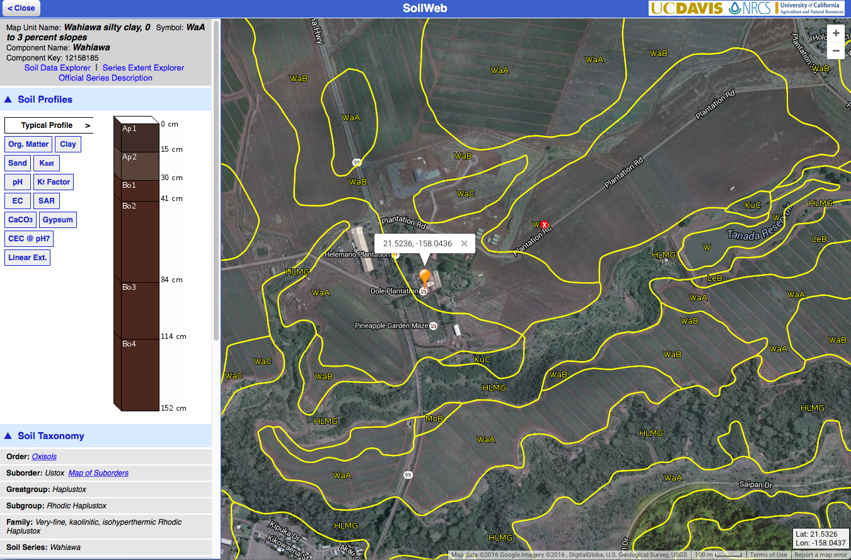
In table 1, record % of slope.
Then click on Org Matter (organic matter).
Source: casoilresource.lawr.ucdavis.edu/gmap/
Notes:
In the Soil Variables table, record % of slope. Then click on Org Matter (organic matter).

Slide 21
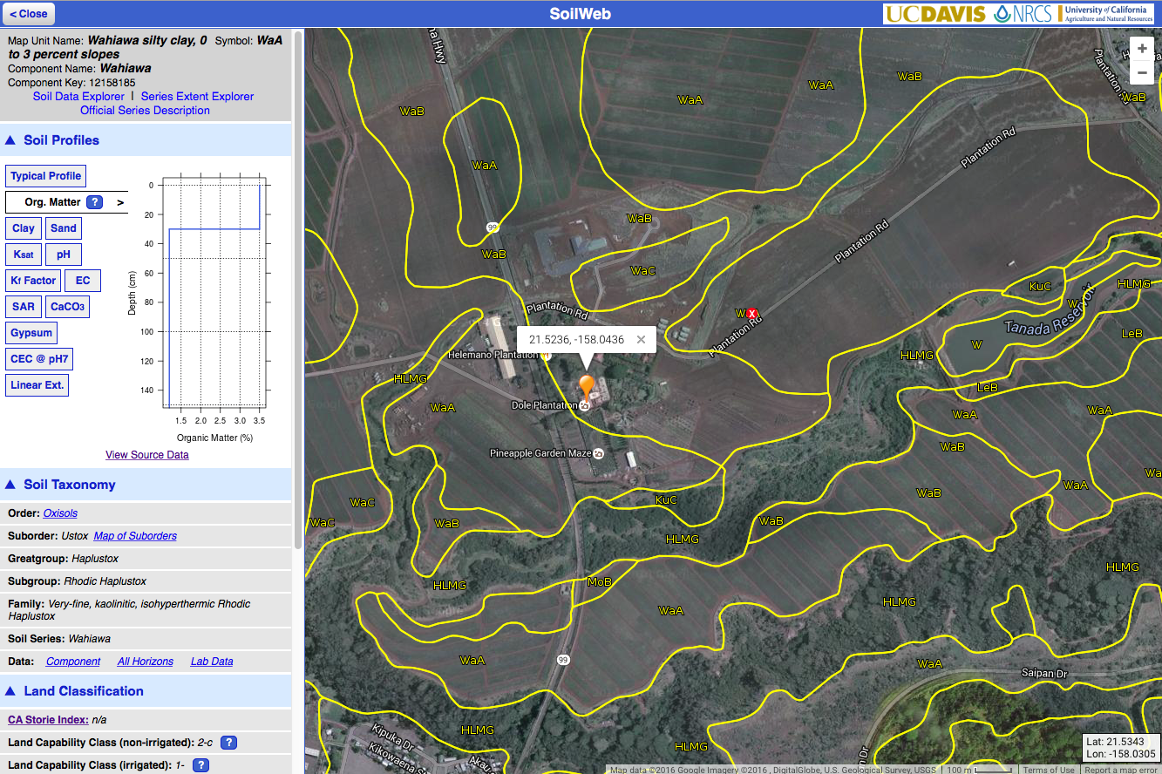
Below the graph, click on View Source Data.
Source: casoilresource.lawr.ucdavis.edu/gmap/
Notes:
Below the graph, click on the View Source Data link.

Slide 22
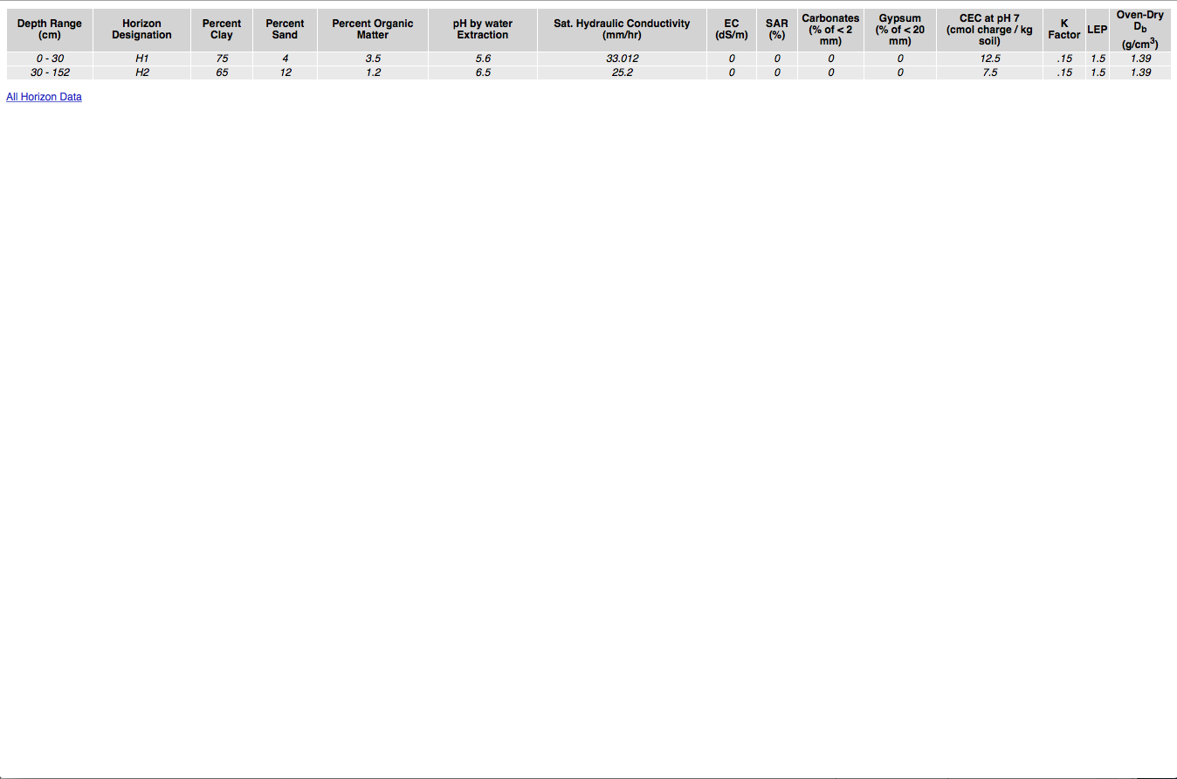
Use the data table to complete the table for percent organic matter and pH.
Source: casoilresource.lawr.ucdavis.edu/soil_web/property_with_depth_table.php?cokey=12158185
Notes:
Find percent organic matter and pH by water extraction on the data table, and record them in the Soil Variables table.

Slide 23
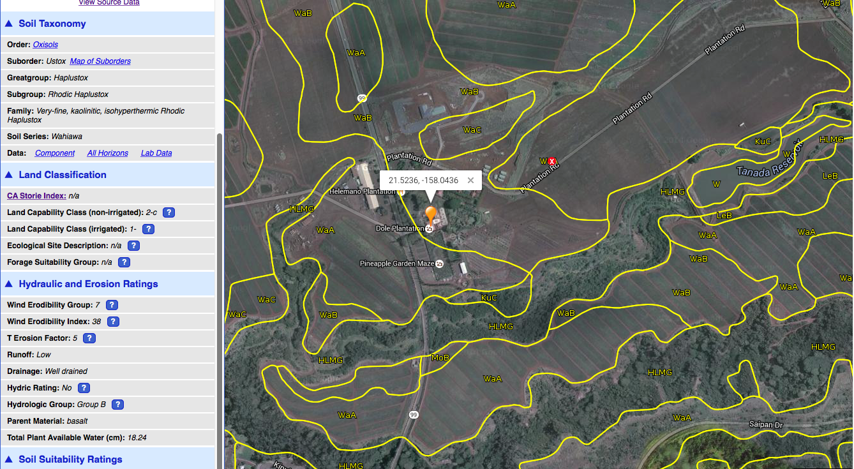
Click on the blue triangle next to Hydraulic and Erosion Ratings to complete the table for Runoff.
Source: casoilresource.lawr.ucdavis.edu/gmap/
Notes:
Click on the blue triangle next to Hydraulic and Erosion Ratings to find Runoff, and record it in the Soil Variables table.

Slide 24
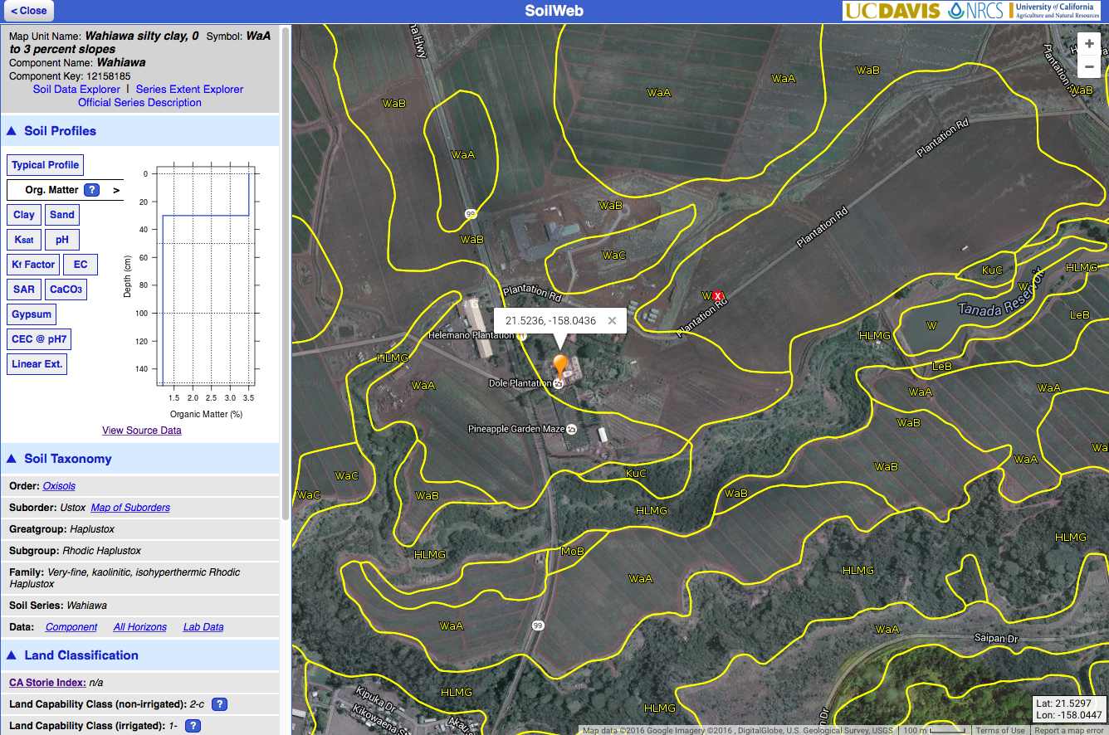
In the left-hand corner, press the Close button until you get back to the Menu button. Repeat steps for the next location to complete table 1.
Source: casoilresource.lawr.ucdavis.edu/gmap/
Notes:
In the left-hand corner, press the Close button until you get back to the Menu button. Repeat steps d-l for the next location until you have completed the first three columns of the Soil Variables table.

Slide 25
To complete the Soil Variables table, choose Use My Current Location, and repeat previous steps.
Source: casoilresource.lawr.ucdavis.edu/gmap/
Notes:
Begin at step d to complete the last column of the Soil Variables table for your location. Instead of entering coordinates in step f, click “Use My Current Location.” Use the “+” button in the right hand corner to zoom in on the map to find your location, and click on the soil code nearest your location.

Slide 26
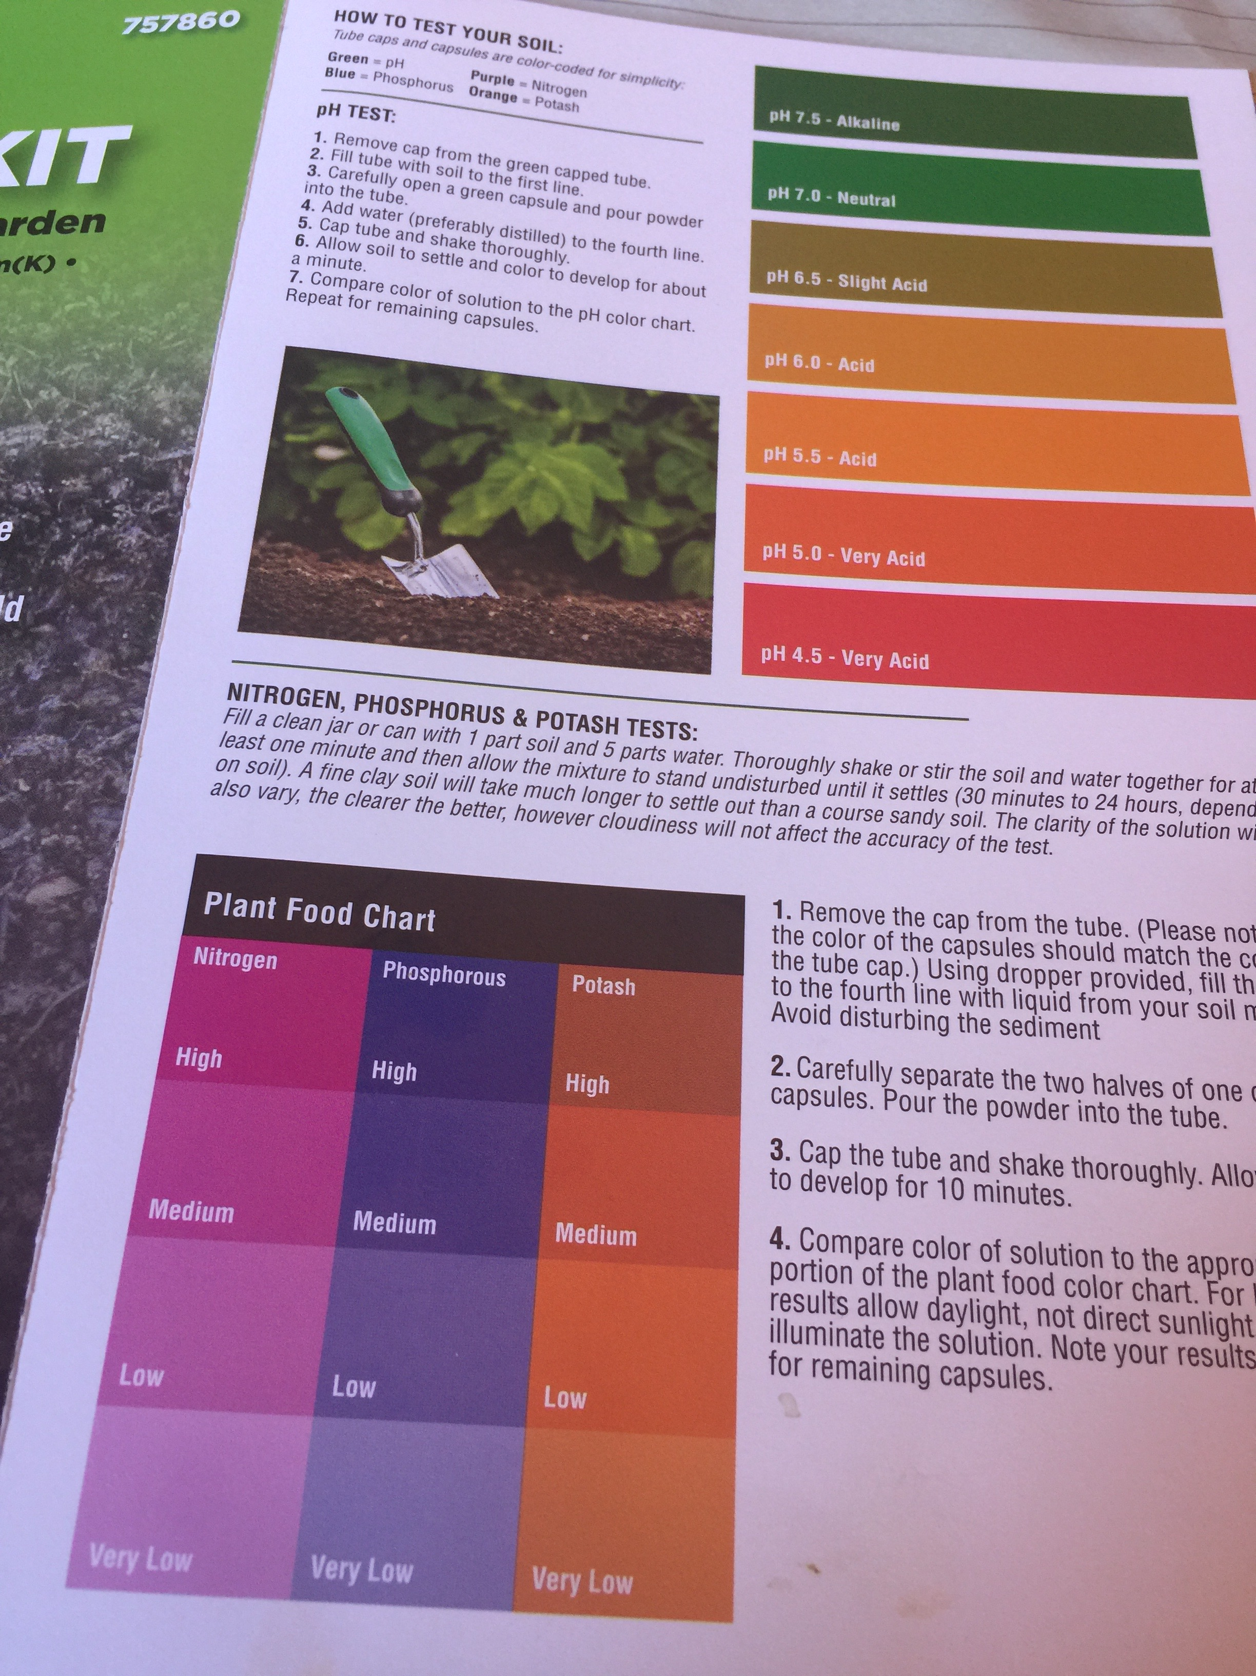
Return to Soil Quality Testing
Examine tubes & compare to charts
Match the shade of the color as closely as possible
Notes:
Examine the tubes and compare the color to the copies of the color charts from the soil test kits to determine nutrient and pH levels. Try to match the shade of your test as closely as possible to the color chart. Make determinations of nutrient levels, from high to very low, and determine the number level of your pH test.

